Slide 1
OS’23 Project
Milestone 3: CPU
FAULT HANDLER Ii & cpu scheduler

Slide 2

Agenda
Logistics
Part 0: Code Updates
Part 1: Fault Handler II
FIFO Replacement
Approx. LRU Replacement
Part 2: BSD Scheduler
OVERALL Testing
BONUSES
Summary & Quick Guide
How to submit?

Slide 3
Logistics
Dependency:
MS1: dynamic allocator (alloc_block_FF & free_block)
MS2: kernel heap (kmalloc, k_virtial_address & k_physical_address)
MS2: placement
Delivery Method: GOOGLE FORM
It’s FINAL delivery
MUST deliver the required tasks and ENSURE they’re worked correctly
Delivery Dates:
SAT of Week #12 (16/12 @11:59 PM)
Upload your code EARLY as NO EXCEPTION will be accepted.
Support:
The support for teams will be via their MENTORS ONLY (+Lecturer) during the published weekly office hours.

Slide 4
Logistics
ADVICE#1: WORK AS A TEAM
Milestone 3: CPU
Fault Handler II: 3 functions
CPU Scheduling: 4 functions
OVERALL Testing
Average # Functions / Member = 7 / 5 members
ADVICE#2: START immediately!
To have the chance to ask and to understand errors in your code in whatever you want during your mentor’s support before the deadline.
ADVICE#3: MUST read the ppt & doc CAREFULLY
Detailed steps
Helper ready made functions (appendices)
≈ 1~2 Functions/Member + OVERALL Testing on 3 Weeks

Slide 5
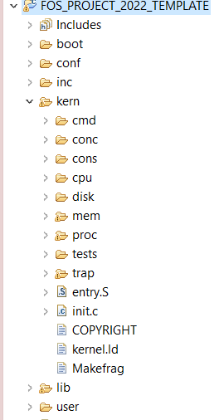




PROJECT BIG PICTURE
inc (.h)
CPU Sched.
(MLFQ-Like)
lib (.c)
Fault Handler II
(Replacement)
[MS1] Preprocessing
user
kern
[MS2] MEMORY
CPU Sched
[MS3] CPU
Fault Handler II

Slide 6
Code Updates
PART0: PREREQUISITES

Slide 7
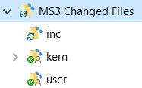
New Files
SELECT ALL in the given “Changed files” folder,
COPY & PASTE (REPLACE ALL) in FOS_CODES/FOS_PROJECT_2023_TEMPLATE/
NOTE: If any of these files are already edited by you in MS1, make sure to apply the edits in the new files

Slide 8
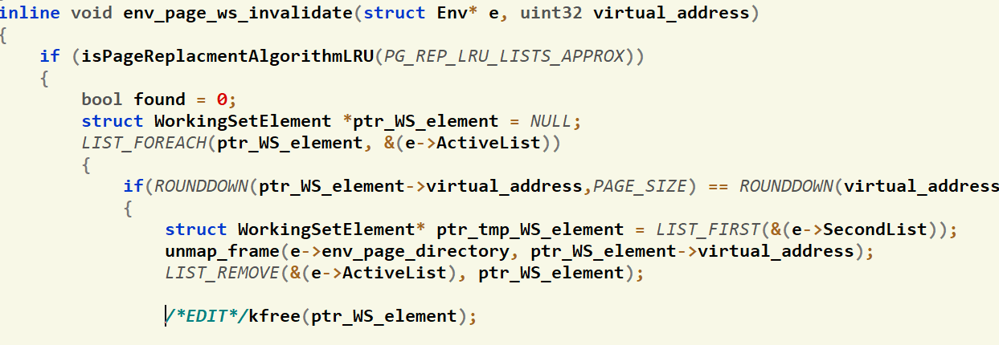
Code Modification
Inside kern/mem/working_set_manager.c, apply the following changes:
Add the following two lines inside the env_page_ws_invalidate() function:
Notes:
if (!is_initialized)
{
uint32 required_size = size + sizeOfMetaData();
uint32 da_start = (uint32)sbrk(required_size);
//get new break since it's page aligned! thus, the size can be more than the required one
uint32 da_break = (uint32)sbrk(0);
initialize_dynamic_allocator(da_start, da_break - da_start);
}

Slide 9
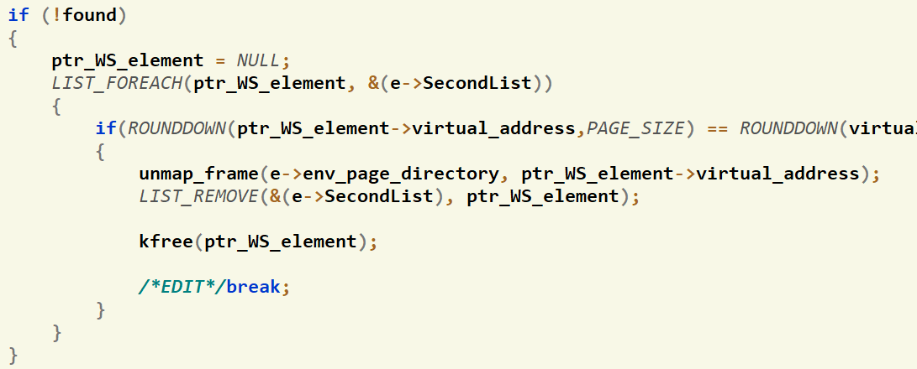
Code Modification
Inside kern/mem/working_set_manager.c, apply the following changes:
Add the following two lines inside the env_page_ws_invalidate() function:
Notes:
if (!is_initialized)
{
uint32 required_size = size + sizeOfMetaData();
uint32 da_start = (uint32)sbrk(required_size);
//get new break since it's page aligned! thus, the size can be more than the required one
uint32 da_break = (uint32)sbrk(0);
initialize_dynamic_allocator(da_start, da_break - da_start);
}

Slide 10
Given Codes
APPENDICES:
ENTRY MANIPULATION in TABLES and DIRECTORY
PAGE FILE HELPER FUNCTIONS
WORKING SET STRUCTURE & HELPER FUNCTIONS
SCHEDULER STRUCTURE & HELPER FUNCTIONS
MEMORY MANAGEMENT FUNCTIONS
READY-MADE COMMANDS
FIXED POINT OPERATIONS

Slide 11

Agenda
Logistics
Part 0: Code Updates
Part 1: Fault Handler II
FIFO Replacement
Approx. LRU Replacement
Part 2: BSD Scheduler
OVERALL Testing
BONUSES
Summary & Quick Guide
How to submit?

Slide 12
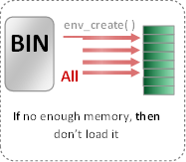

Load Program [env_create] [already DONE]
Now: in Project
Prev: in Labs
TWO kernel dynamic allocations:
create_page_table(): create new page table and link it to directory.
create_user_directory(): create new user directory.
env_create( )
BIN
Set of pages
Required Tables
All Pages
BIN
Segment 1, page 1
Loaded in virtual address 201000
201000
WS_Last_element
Segment 1, page 2
Loaded in virtual address 202000
202000
Refer to APPENDICES for:
Segment 1, page 3
203000
Loaded in virtual address 203000
Segment 2, page 1
801000
Page File Helper Functions
Loaded in virtual address 801000
Segment 2, page 2
USTAKTOP —PAGESIZE
NOT Loaded in main memory
Program Binary Segments and pages
Working Set after loading (pages_WS_size = 5)
Working Set Structure & Helper Functions
First Stack Page
Ready-Made Commands

Slide 13
Fault Handler II: Replacement
The main functions required by MS3 to handle “Page Fault” are:
# | Function | File
1 | page_fault_handler | Functions definitions TO DO in: kern/trap/fault_handler.c

Slide 14
Fault Handler I: Introduction
Fault: is an exception thrown by the processor (MMU) to indicate that:
A page table is not exist in the main memory (i.e. new table). (see the following figure) OR
A page can’t be accessed due to either it’s not present in the main memory

Slide 15
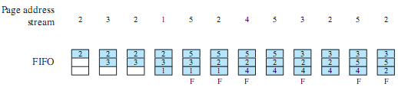
Replac#1: FIFO – Idea
Treats allocated frames as a circular buffer
Pages are removed in round-robin style
Adv: Simplest to implement
DisAdv: first-loaded pages may be needed again very soon
Notes:
The first-in-first-out (FIFO) policy treats the page frames allocated to a process as a circular buffer, and pages are removed in round-robin style.
All that is required is a pointer that circles through the page frames of the process.
This is one of the simplest page replacement policies to implement.
The logic behind this choice is that one is replacing the page that has been in memory the longest:
A page fetched into memory a long time ago may have now fallen out of use.
This reasoning will often be wrong, because there will often be regions of program or data that are heavily used throughout the life of a program.
Those pages will be repeatedly paged in and out by the FIFO algorithm.

Slide 16
Replac#1: FIFO – Data Structures
Each environment has a LIST of WorkingSetElement called "page_WS_list" that is initialized in env_create()
Its max size is set in "page_WS_max_size" during the env_create().
"page_last_WS_element" will point to either:
the next location in the WS after the last set one If list is full.
Null if the list is not full.
IMP. NOTE: you should maintain page_last_WS_element & correct FIFO order of the List in rest of code (page_fault_handler, free_user_mem, sys_sbrk…)
Notes:
The first-in-first-out (FIFO) policy treats the page frames allocated to a process as a circular buffer, and pages are removed in round-robin style.
All that is required is a pointer that circles through the page frames of the process.
This is one of the simplest page replacement policies to implement.
The logic behind this choice is that one is replacing the page that has been in memory the longest:
A page fetched into memory a long time ago may have now fallen out of use.
This reasoning will often be wrong, because there will often be regions of program or data that are heavily used throughout the life of a program.
Those pages will be repeatedly paged in and out by the FIFO algorithm.

Slide 17
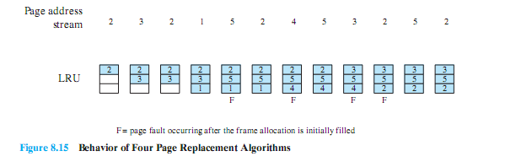
Replac#2: LRU – Idea#1
Replaces the page that has not been referenced for the longest time.
Adv: BEST feasible
Probs: Difficult to implement .. WHY??
HOW do you tag each page with the time of last reference to be able to implement LRU.

Slide 18
Replac#2: LRU – Idea#1
So, how to implement LRU?
On each use, remove page from list and place at head
LRU page is at tail
Use a list!
Head
Tail (LRU)

Slide 19
Replac#2: LRU – Idea#1
Example - If we have the following references:
Page 2:
(Page Fault)
Page 1:
(Page Fault)
Page 6:
(Page Fault)
Page 1:
(ACCESS already Existing page)
Use a list!
Head
P2
Tail (LRU)
Head
Head
P1
P2
Tail (LRU)
Tail (LRU)
Problems?
Need to know immediately when each page used so that can change position in list…
Head
P6
P1
P2
Tail (LRU)
Head
P6
P2
Head
P1
P6
P2
Tail (LRU)
Tail (LRU)

Slide 20
Replac#2: LRU – Idea#1
So, to implement LRU with know immediately when each page used:
Page 2:
(Page Fault)
Page 1:
(Page Fault)
Page 6:
(Page Fault)
Page 1:
(ACCESS already Existing page)
Head
P2
Tail (LRU)
Solution ?!!
With handling each page fault, MARK all pages as NOT present, even if in memory, except the FAULTED one (head)
So, on reading a NOT present page, trap to OS (fault handler) to control ..
That’s what we need ☺
P = 0
Head
P1
P2
Tail (LRU)
P = 0
P = 0
Head
P6
P1
P2
Page
Fault
Tail (LRU)
This is known as: PERFECT LRU
Head
P1
P6
P2
Tail (LRU)

Slide 21
Replac#2: LRU – Idea#1
Disadvantages ?!!
Page fault exception with each access to a page (either exists or not).. So, for each user reference:
CPU will be switched from user to kernel mode to handle the page fault (1 reference -> execute code)
Increase time required to handle ONE page access
Increase overhead in the memory access.
Solution ?!!
With handling each page fault, MARK all pages as NOT present, even if in memory, except the FAULTED one (head)
So, on reading a NOT present page, trap to OS (fault handler) to control ..
That’s what we need ☺
This is known as: PERFECT LRU

Slide 22
Replac#2: LRU – Idea#2: List Approx
Linked LIST 1: Directly Mapped Pages
Marked: PRESENT
List: FIFO
Linked LIST 2:
Second Chance List
Marked: NOT PRESENT
List: LRU
New
Active
Pages
New
SC
Victims
Remember:
This approach is an approximation to the PERFECT LRU to avoid its disadvantages
But HOW?

Slide 23
Replac#2: LRU – Idea#2: List Approx
Assume we have the following references with 2 EMPTY lists:
LIST 1: Directly Mapped Pages
Max Size = 3
LIST 2: Second Chance List
Max Size = 3
5- P5
6- P6
4- P4
3- P3
2- P2
1-P1
P1
So, for each page fault, add it in LIST 1
When LIST 1 is FULL:
Remove a page from LIST 1 using FIFO
Place the removed page at the head of LIST 2
Place the new faulted page at the head of LIST 1
P4
P2
P1
P3
P1
P1
List 1 is FULL!!
Overflow
P5
P1
P2
P1
P3
P4
P1
P2
P1
P2
Then, apply FIFO
P6
P3
P3
P4
P5
P2
P2
Head
P1
P1
P = 1
P = 0
Page-in
From disk
New
Active
Pages
New
SC
Victims

Slide 24
Replac#2: LRU – Idea#2: List Approx
Now, the 2 lists are FULL, and a new FAULT is happened:
LIST 1: Directly Mapped Pages
Max Size = 3
LIST 2: Second Chance List
Max Size = 3
7- P7
P1
P4
P5
P2
P1
P3
P1
P1
P2
LRU victim
Overflow
P5
P1
P2
P1
P3
P3
P6
P4
P1
P2
P1
P2
Extract the LRU page from LIST 2 If Modified ➔ write it to DISK
Read faulted page from DISK
P3
P7
P1
Head
P6
P4
P = 1
P = 0
New
Active
Pages
New
SC
Victims
Page-in
From disk
MODIFIED Page
To Disk

Slide 25
Replac#2: LRU – Idea#2: List Approx
Now, access to already existing page is happened:
LIST 1: Directly Mapped Pages
Max Size = 3
LIST 2: Second Chance List
Max Size = 3
8- P3
P5
P6
P2
P1
P1
P4
P5
P2
P1
P3
P4
P1
P3
P2
P1
P1
P1
P2
Marked: PRESENT
List: FIFO
Overflow
Marked: NOT PRESENT
List: LRU
P7
P1
P5
P6
P2
P1
P3
P4
P4
P5
P3
P3
P2
P1
P4
P1
P2
P1
P2
P7
Access
P3
P3
P5
P4
P5
P3
P2
P1
P1
Head
P4
P = 1
P = 0
New
Active
Pages
New
SC
Victims
Page-in
From disk
Page to
disk

Slide 26
Replac#2: LRU – Data Structures
struct Env holds the following attributes for each process:
struct Env
{
…….
struct WS_List ActiveList; //LRU Approx: ActiveList that should work as FCFS
struct WS_List SecondList; //LRU Approx: SecondList that should work as LRU
int ActiveListSize ; //LRU Approx: Max allowed size of ActiveList
int SecondListSize ; //LRU Approx: Max allowed size of SecondList
int page_WS_max_size; //Max WS Size = ActiveListSize + SecondListSize
…….
Notes:
The first-in-first-out (FIFO) policy treats the page frames allocated to a process as a circular buffer, and pages are removed in round-robin style.
All that is required is a pointer that circles through the page frames of the process.
This is one of the simplest page replacement policies to implement.
The logic behind this choice is that one is replacing the page that has been in memory the longest:
A page fetched into memory a long time ago may have now fallen out of use.
This reasoning will often be wrong, because there will often be regions of program or data that are heavily used throughout the life of a program.
Those pages will be repeatedly paged in and out by the FIFO algorithm.

Slide 27
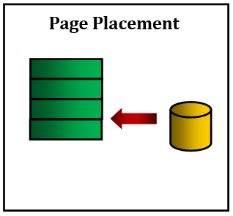
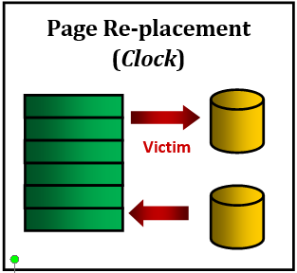
#1: FIFO Re/placement
(FIFO)
page_fault_handler(struct Env * curenv, uint32 fault_va)
if(isPageReplacmentAlgorithmFIFO())
{
if the size of page_WS_list < its max size, then do
{
Scenario 1: Placement
//[DONE in MS2]: [PROJECT'23.MS2] PAGE FAULT HANDLER – Placement
}
else
{
Scenario 2: Replacement
//TODO: [PROJECT'23.MS3 - #1] [1] PAGE FAULT HANDLER - FIFO Replacement
}
}
NOTE: Check MS2 appendices to handle either the working set or the page file using some ready-made functions.

Slide 28
#2, #3: LRU Re/placem.
Page Placement
Page Replacement (LRU Approx)
OR
modified
page_fault_handler(struct Env * curenv, uint32 fault_va)
if(isPageReplacmentAlgorithmLRU(PG_REP_LRU_LISTS_APPROX))
{
if the size of both ActiveList + SecondList < max size, then do
{
Scenario 1: Placement
//TODO: [PROJECT'23.MS3 - #2] [1] PAGE FAULT HANDLER – LRU Placement
}
else
{
Scenario 2: Replacement
//TODO: [PROJECT'23.MS3 - #1] [1] PAGE FAULT HANDLER - LRU Replacement
}
}
NOTE: Check MS2 appendices to handle either the working set or the page file using some ready-made functions.

Slide 29
MS3: Page Fault Handler: Testing (FIFO)
Test each function in MS3 independently in a FRESH SEPARATE RUN
The time limit of each individual test: max of 15 sec / each
All below tests are used to validate the page_fault_handler with FIFO function
# | Test Functionality | Test
1 | tst_page_replacement_alloc.c (tpr1): tests allocation in memory and page file after page replacement. | FOS> run tpr1 11
2 | tst_page_replacement_stack.c (tpr2): tests page replacement of stack (i.e. new pages) (creating, modifying and reading them) | FOS> run tpr2 6
3 | tst_page_replacement_FIFO_1.c (tfifo1): tests page replacement by FIFO algorithm (check working set before and after replacements) | FOS> run tfifo1 11
4 | tst_page_replacement_FIFO_2.c (tfifo2): tests page replacement by FIFO algorithm (check maintaining of page_last_WS_element & correct FIFO order of the List after free_user_mem) | FOS> run tfifo2 11

Slide 30
MS3: Page Fault Handler: Testing (Approx LRU)
Test each function in MS3 independently in a FRESH SEPARATE RUN
The time limit of each individual test: max of 15 sec / each
All below tests are used to validate the page_fault_handler with LRU function
# | Test Functionality | Test (1st num: max size, 2nd num: 2nd list size)
1 | tst_placement_1.c (tpplru1): tests page faults on stack (i.e. new pages) + page placement in case the active list is not FULL. | FOS> run tpplru1 20 2
2 | tst_placement_2.c (tpplru2): tests page faults on stack (i.e. new pages) + page placement in case the active list is FULL, and second active list is NOT FULL. | FOS> run tpplru2 20 7
3 | tst_placement_3.c (tpplru3): tests page faults (placement) on pages already exist in the second active list and the second active list is NOT FULL. | FOS> run tpplru3 20 7
4 | tst_page_replacement_LRU_Lists_1.c (tprlru1): tests allocation in memory and page file after page replacement. | FOS> run tprlru1 10 5
5 | tst_page_replacement_LRU_Lists_2.c (tprlru2): tests the LRU algorithm (check lists content before and after replacements) | FOS> run tprlru2 11 5
6 | tst_page_replacement_stack_LRU_Lists.c (tprlru3): tests page replacement of stack (i.e. new pages) (creating, modifying and reading them) | FOS> run tprlru3 6 3

Slide 31

Agenda
Logistics
Part 0: Code Updates
Part 1: Fault Handler II
FIFO Replacement
Approx. LRU Replacement
Part 2: BSD Scheduler
OVERALL Testing
BONUSES
Summary & Quick Guide
How to submit?

Slide 32

BSD Scheduler: Overview
Refer to APPENDICES for:
Scheduler Functions
WHAT?
Example of Multilevel Feedback Queue (MLFQ).
It maintains several queues of ready processes
each queue holds processes with a different priority.
At any given time:
the scheduler chooses a process from the highest-priority non-empty queue.
If the highest-priority queue contains multiple processes, then they run in "round robin" order.
P₁₀
…
P₄
P₁
CPU
P₁₅
…
P₆
P₂
Decreasing Priority
.
.
.
P₁₂
…
P₅
P₃

Slide 33
BSD Scheduler: Overview
Refer to APPENDICES for:
Scheduler Functions
WHY?
Try to balance processes' different scheduling needs.
I/O-Bound Processes: perform a lot of I/O, require a fast response time to keep I/O devices busy, but need little CPU time.
CPU-Bound Processes: need to receive a lot of CPU time to finish their work, but have no requirement for fast response time.
Others: lie somewhere in between, with periods of I/O punctuated by periods of computation, and thus have requirements that vary over time.
I/O
CPU
I/O
CPU
I/O
CPU
I/O
CPU
I/O
CPU

Slide 34
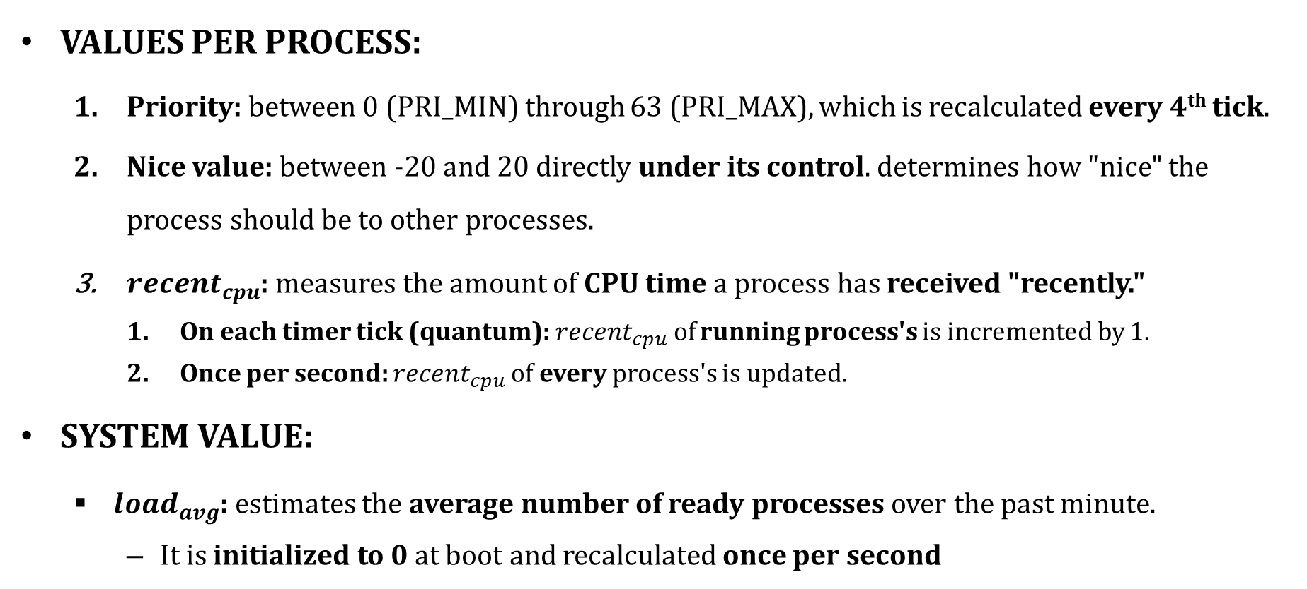
BSD Scheduler: Big Picture – DATA
VALUES PER PROCESS:
Priority: between 0 (PRI_MIN) through 63 (PRI_MAX), which is recalculated every 4th tick.
Nice value: between -20 and 20 directly under its control. determines how "nice" the process should be to other processes.
$recent_{cpu}$: measures the amount of CPU time a process has received "recently."
On each timer tick (quantum): $recent_{cpu}$of running process's is incremented by 1.
Once per second: $recent_{cpu}$of every process's is updated.
SYSTEM VALUE:
$load_{avg}$: estimates the average number of ready processes over the past minute.
It is initialized to 0 at boot and recalculated once per second

Slide 35
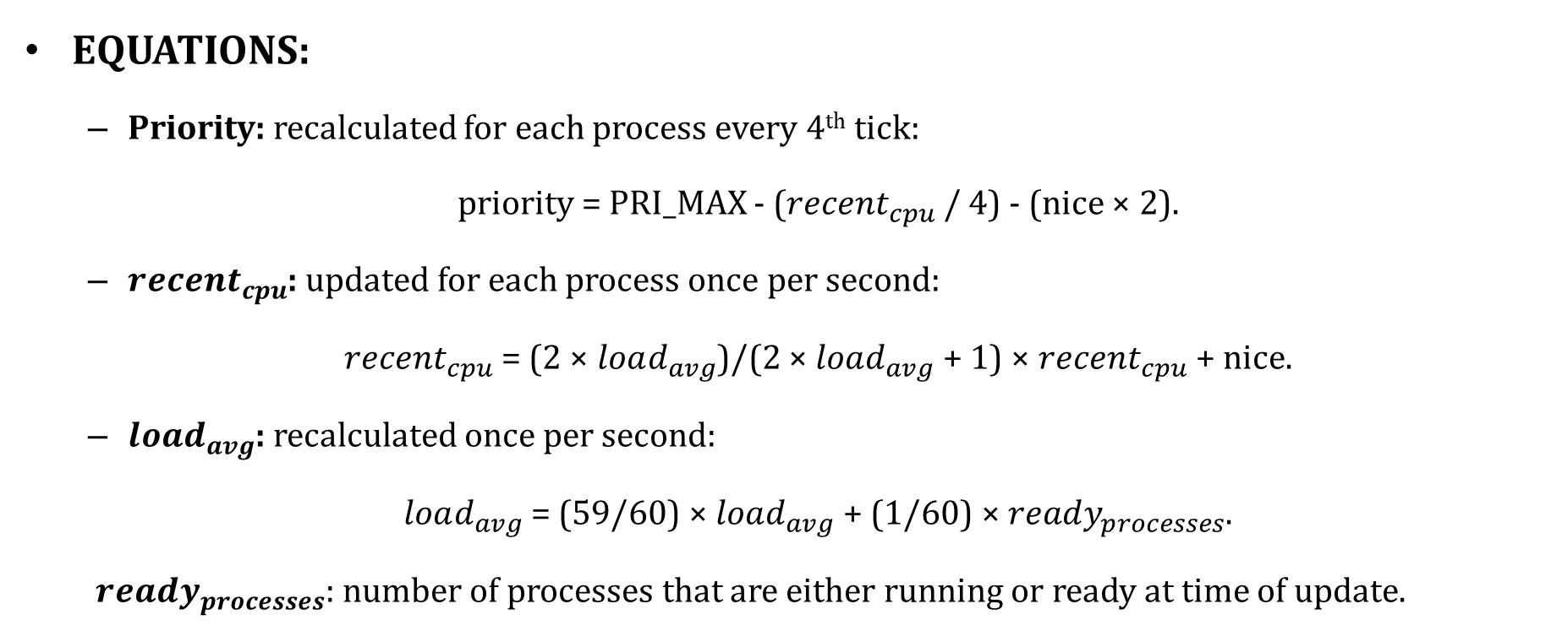
BSD Scheduler: Big Picture – EQUs
EQUATIONS:
Priority: recalculated for each process every 4th tick:
priority = PRI_MAX - ($recent_{cpu}$/ 4) - (nice × 2).
$recent_{cpu}$: updated for each process once per second:
$recent_{cpu}$= (2 × $load_{avg}$)/(2 × $load_{avg}$+ 1) × $recent_{cpu}$+ nice.
$load_{avg}$: recalculated once per second:
$load_{avg}$= (59/60) × $load_{avg}$+ (1/60) × $ready_{processes}$.
$ready_{processes}$: number of processes that are either running or ready at time of update.

Slide 36
BSD Scheduler: Details – Niceness
IDEA
determines how "nice" the process should be to other processes.
If = 0: does not affect process priority.
If +ve: to the maximum of 20, decreases the priority of a process and causes it to give up some CPU time it would otherwise receive.
If -ve: to the minimum of -20, tends to take away CPU time from other processes.
CALCULATION
Initial process starts with a nice value of zero.
Can be changed by a process (via system call) or the kernel

Slide 37
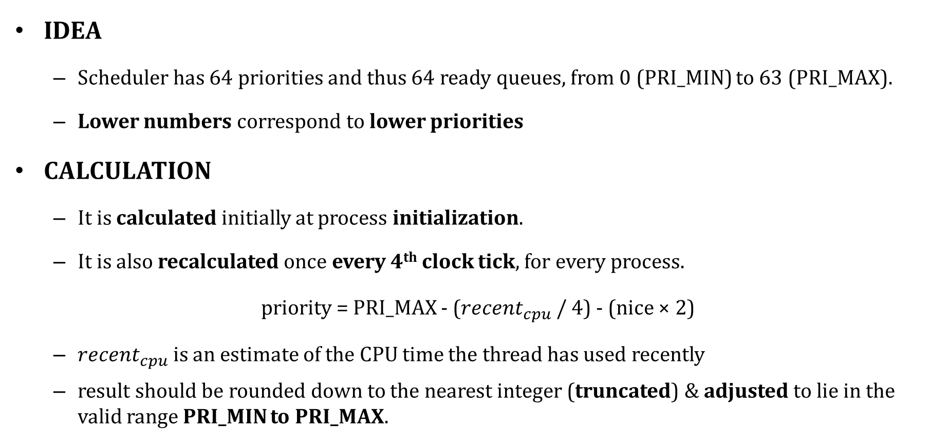
BSD Scheduler: Details – Priority
IDEA
Scheduler has 64 priorities and thus 64 ready queues, from 0 (PRI_MIN) to 63 (PRI_MAX).
Lower numbers correspond to lower priorities
CALCULATION
It is calculated initially at process initialization.
It is also recalculated once every 4th clock tick, for every process.
priority = PRI_MAX - ($recent_{cpu}$/ 4) - (nice × 2)
$recent_{cpu}$is an estimate of the CPU time the thread has used recently
result should be rounded down to the nearest integer (truncated) & adjusted to lie in the valid range PRI_MIN to PRI_MAX.
nice
prior.
nice
prior.
CPU
prior.
CPU
prior.

Slide 38
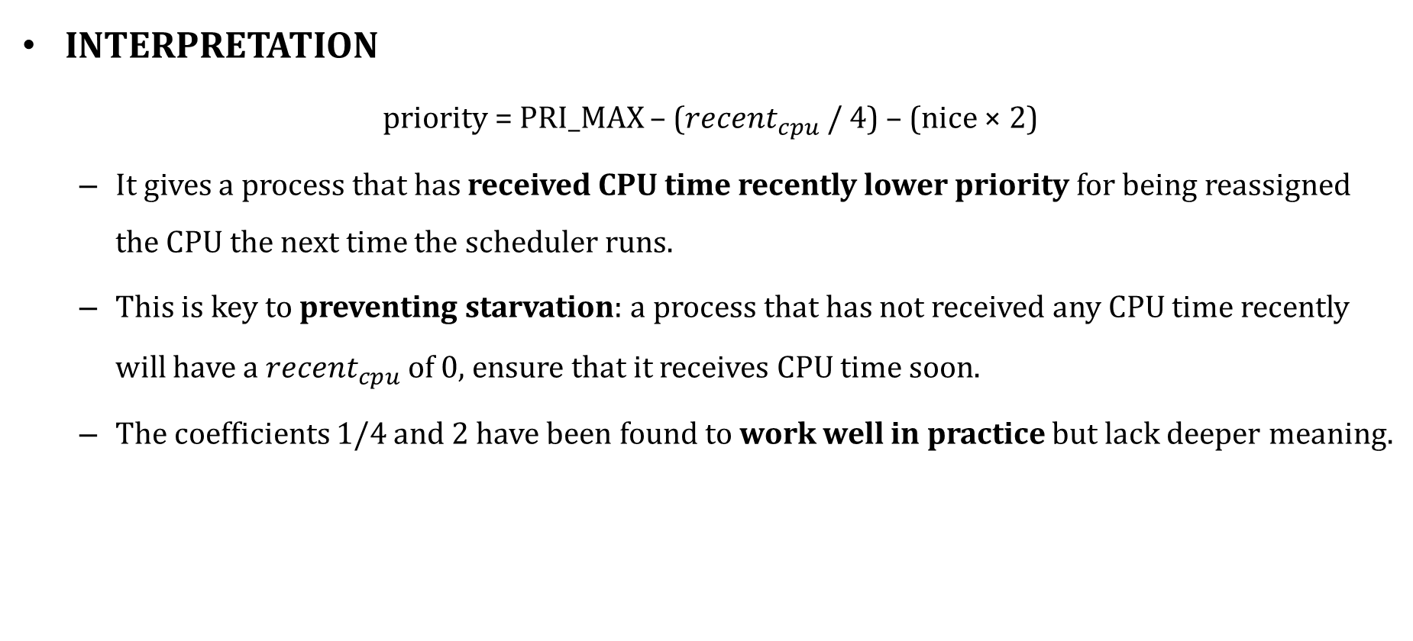
BSD Scheduler: Details – Priority
INTERPRETATION
priority = PRI_MAX – ($recent_{cpu}$/ 4) – (nice × 2)
It gives a process that has received CPU time recently lower priority for being reassigned the CPU the next time the scheduler runs.
This is key to preventing starvation: a process that has not received any CPU time recently will have a $recent_{cpu}$of 0, ensure that it receives CPU time soon.
The coefficients 1/4 and 2 have been found to work well in practice but lack deeper meaning.

Slide 39
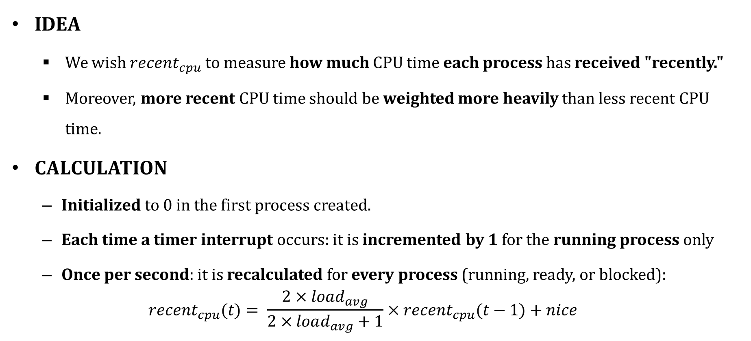
BSD Scheduler: Details – Recent CPU
IDEA
We wish $recent_{cpu}$to measure how much CPU time each process has received "recently."
Moreover, more recent CPU time should be weighted more heavily than less recent CPU time.
CALCULATION
Initialized to 0 in the first process created.
Each time a timer interrupt occurs: it is incremented by 1 for the running process only
Once per second: it is recalculated for every process (running, ready, or blocked):
$$recent_{cpu}(t)= \frac{2×load_{avg}}{2×load_{avg}+1}×recent_{cpu}(t−1)+nice$$

Slide 40
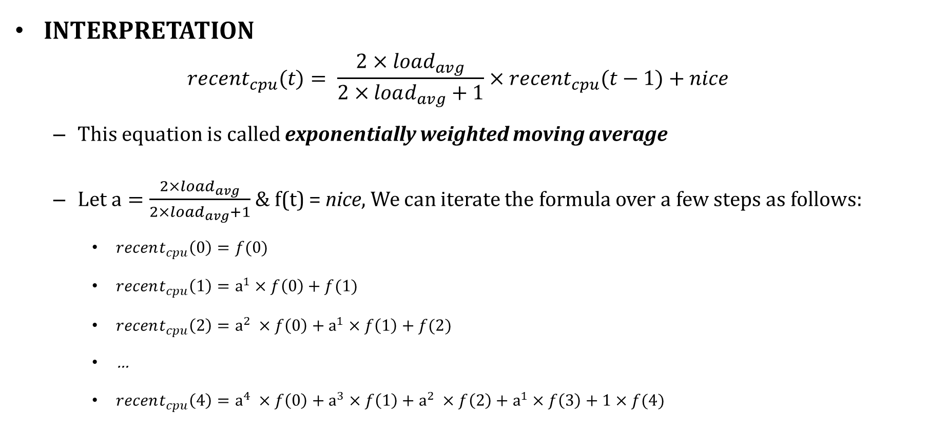
BSD Scheduler: Details – Recent CPU
INTERPRETATION
$$recent_{cpu}(t)= \frac{2×load_{avg}}{2×load_{avg}+1}×recent_{cpu}(t−1)+nice$$
This equation is called exponentially weighted moving average
Let $a=\frac{2×load_{avg}}{2×load_{avg}+1}$ & f(t) = nice, We can iterate the formula over a few steps as follows:
$recent_{cpu}\left(0\right)=f(0)$
$recent_{cpu}\left(1\right)=a^{1}×f\left(0\right)+f(1)$
$recent_{cpu}\left(2\right)=a^{2} ×f\left(0\right)+a^{1}×f\left(1\right)+f(2)$
…
$recent_{cpu}\left(4\right)=a^{4} ×f\left(0\right)+a^{3}×f\left(1\right)+a^{2} ×f\left(2\right)+a^{1}×f\left(3\right)+1×f(4)$
a
f(t)
The value of f(t) has:
a weight of 1 at time t,
a weight of a at time t-1,
a weight of a² at time t-2,
and so on…
DECAYED Weight

Slide 41
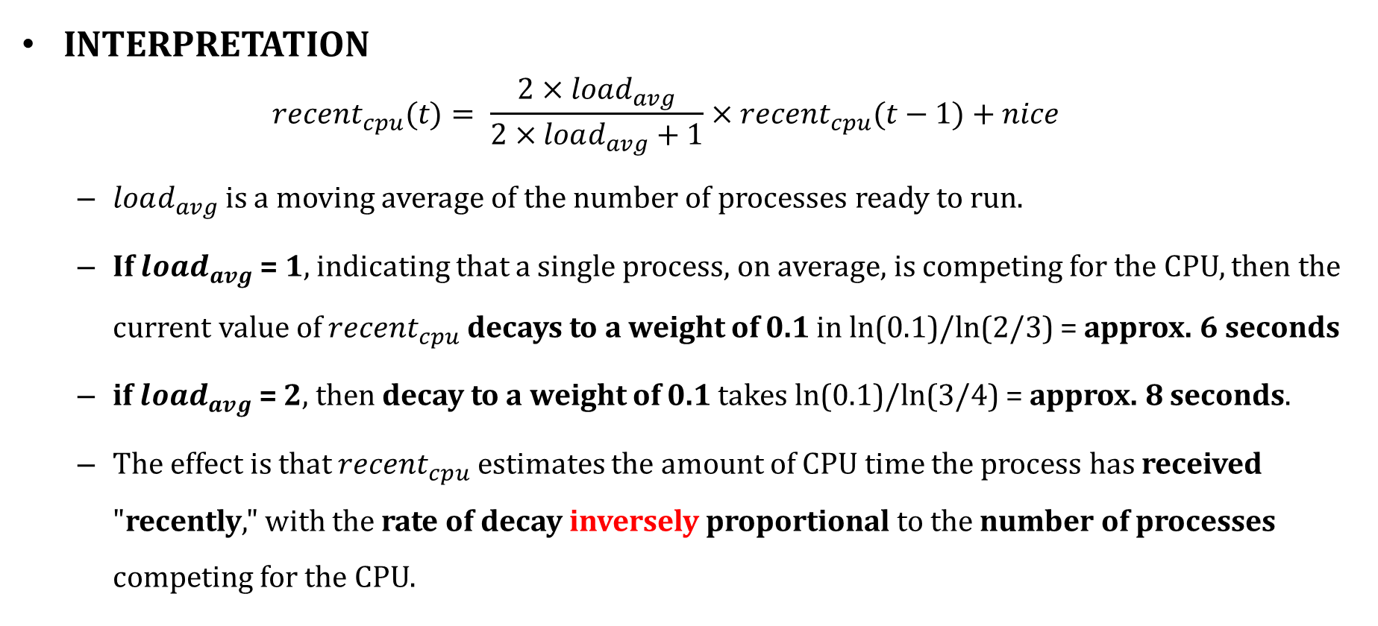
BSD Scheduler: Details – Recent CPU
INTERPRETATION
$$recent_{cpu}(t)= \frac{2×load_{avg}}{2×load_{avg}+1}×recent_{cpu}(t−1)+nice$$
$load_{avg}$is a moving average of the number of processes ready to run.
If $load_{avg}$= 1, indicating that a single process, on average, is competing for the CPU, then the current value of $recent_{cpu}$decays to a weight of 0.1 in ln(0.1)/ln(2/3) = approx. 6 seconds
if $load_{avg}$= 2, then decay to a weight of 0.1 takes ln(0.1)/ln(3/4) = approx. 8 seconds.
The effect is that $recent_{cpu}$ estimates the amount of CPU time the process has received "recently," with the rate of decay inversely proportional to the number of processes competing for the CPU.

Slide 42
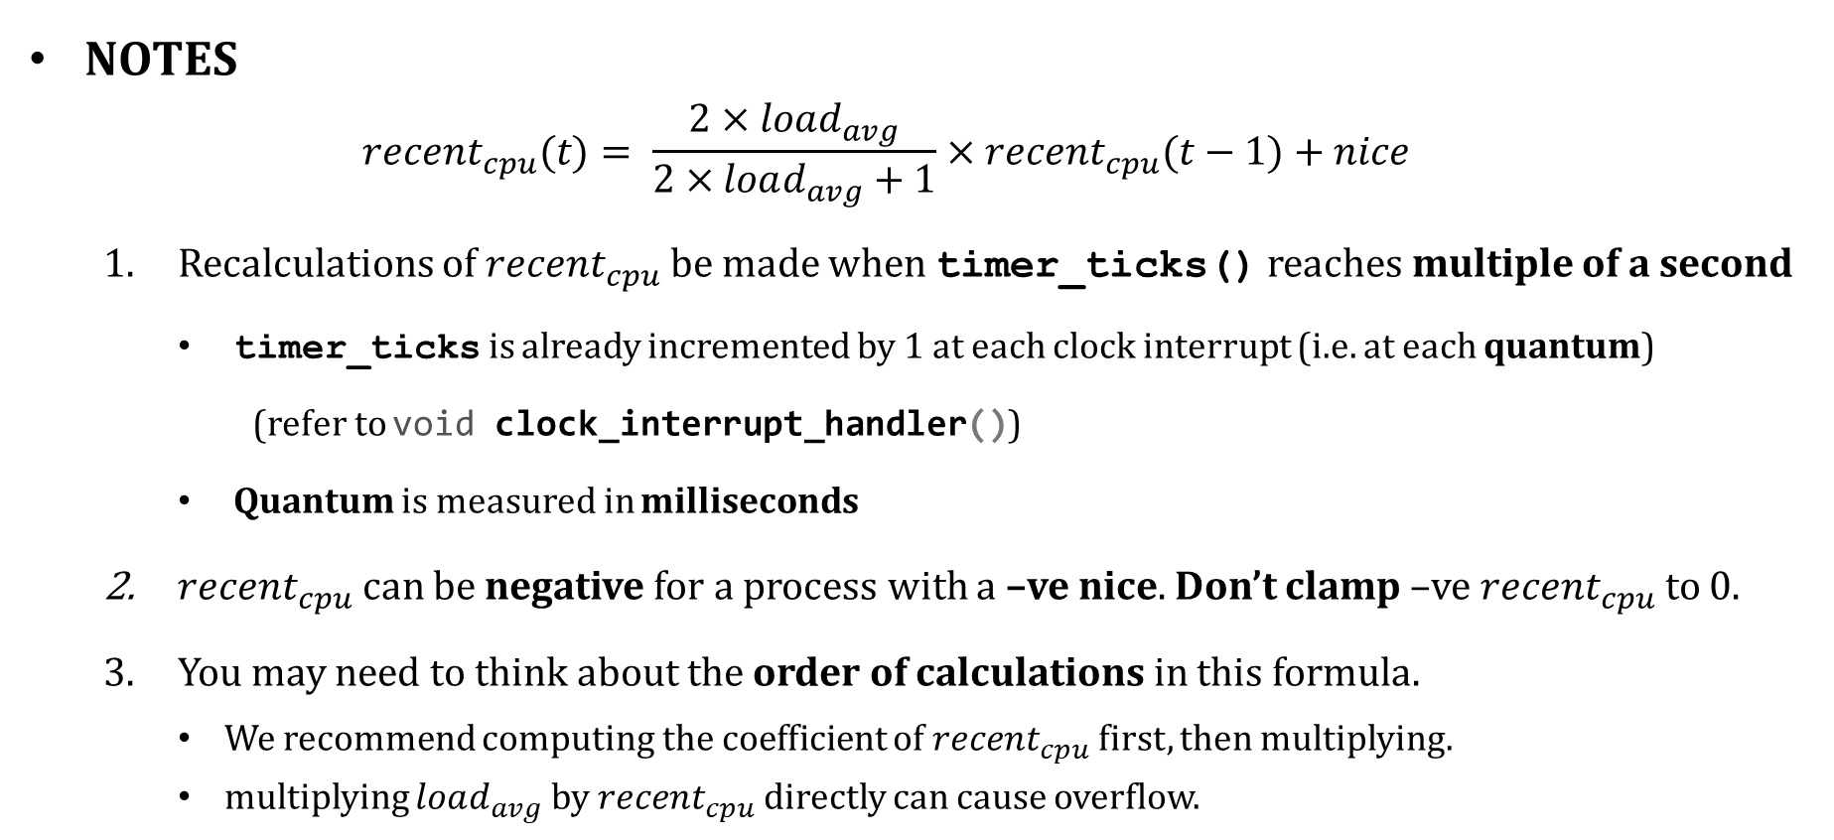
BSD Scheduler: Details – Recent CPU
NOTES
$$recent_{cpu}(t)= \frac{2×load_{avg}}{2×load_{avg}+1}×recent_{cpu}(t−1)+nice$$
Recalculations of $recent_{cpu}$be made when timer_ticks() reaches multiple of a second
timer_ticks is already incremented by 1 at each clock interrupt (i.e. at each quantum)
(refer to void clock_interrupt_handler())
Quantum is measured in milliseconds
$recent_{cpu}$can be negative for a process with a –ve nice. Don’t clamp –ve $recent_{cpu}$to 0.
You may need to think about the order of calculations in this formula.
We recommend computing the coefficient of $recent_{cpu}$first, then multiplying.
multiplying $load_{avg}$ by $recent_{cpu}$directly can cause overflow.

Slide 43
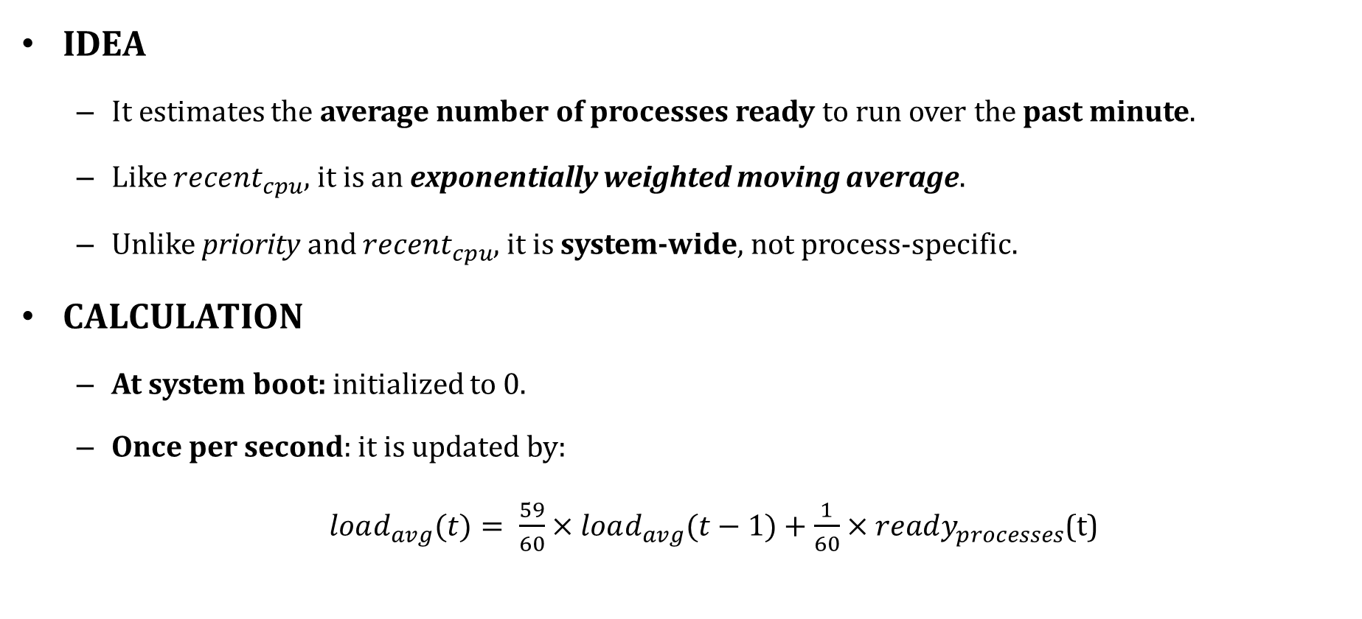
BSD Scheduler: Details – Load Avg
IDEA
It estimates the average number of processes ready to run over the past minute.
Like $recent_{cpu}$, it is an exponentially weighted moving average.
Unlike priority and $recent_{cpu}$, it is system-wide, not process-specific.
CALCULATION
At system boot: initialized to 0.
Once per second: it is updated by:
$load_{avg}(t)= \frac{59}{60}×load_{avg}(t−1)+\frac{1}{60}×ready_{processes}$(t)

Slide 44
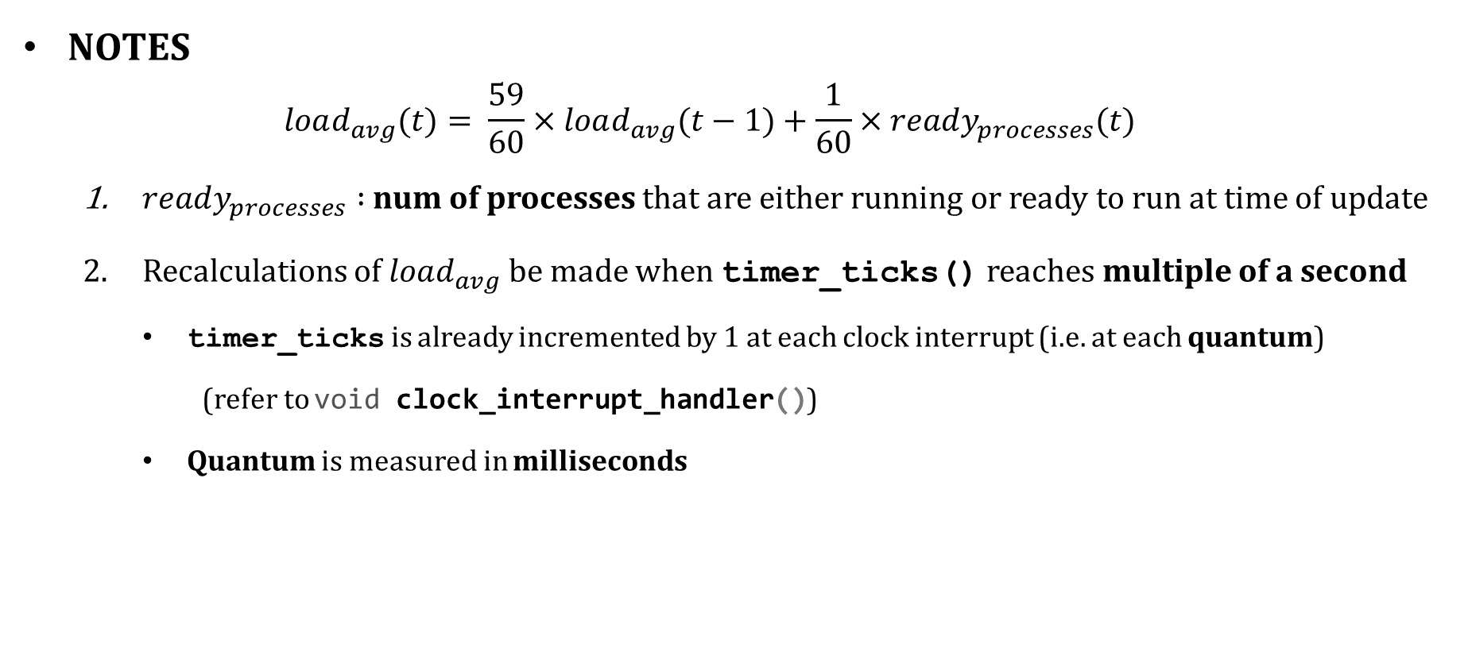
BSD Scheduler: Details – Load Avg
NOTES
$$load_{avg}(t)= \frac{59}{60}×load_{avg}(t−1)+\frac{1}{60}×ready_{processes}(t)$$
$ready_{processes} :$ num of processes that are either running or ready to run at time of update
Recalculations of $load_{avg}$ be made when timer_ticks() reaches multiple of a second
timer_ticks is already incremented by 1 at each clock interrupt (i.e. at each quantum)
(refer to void clock_interrupt_handler())
Quantum is measured in milliseconds

Slide 45
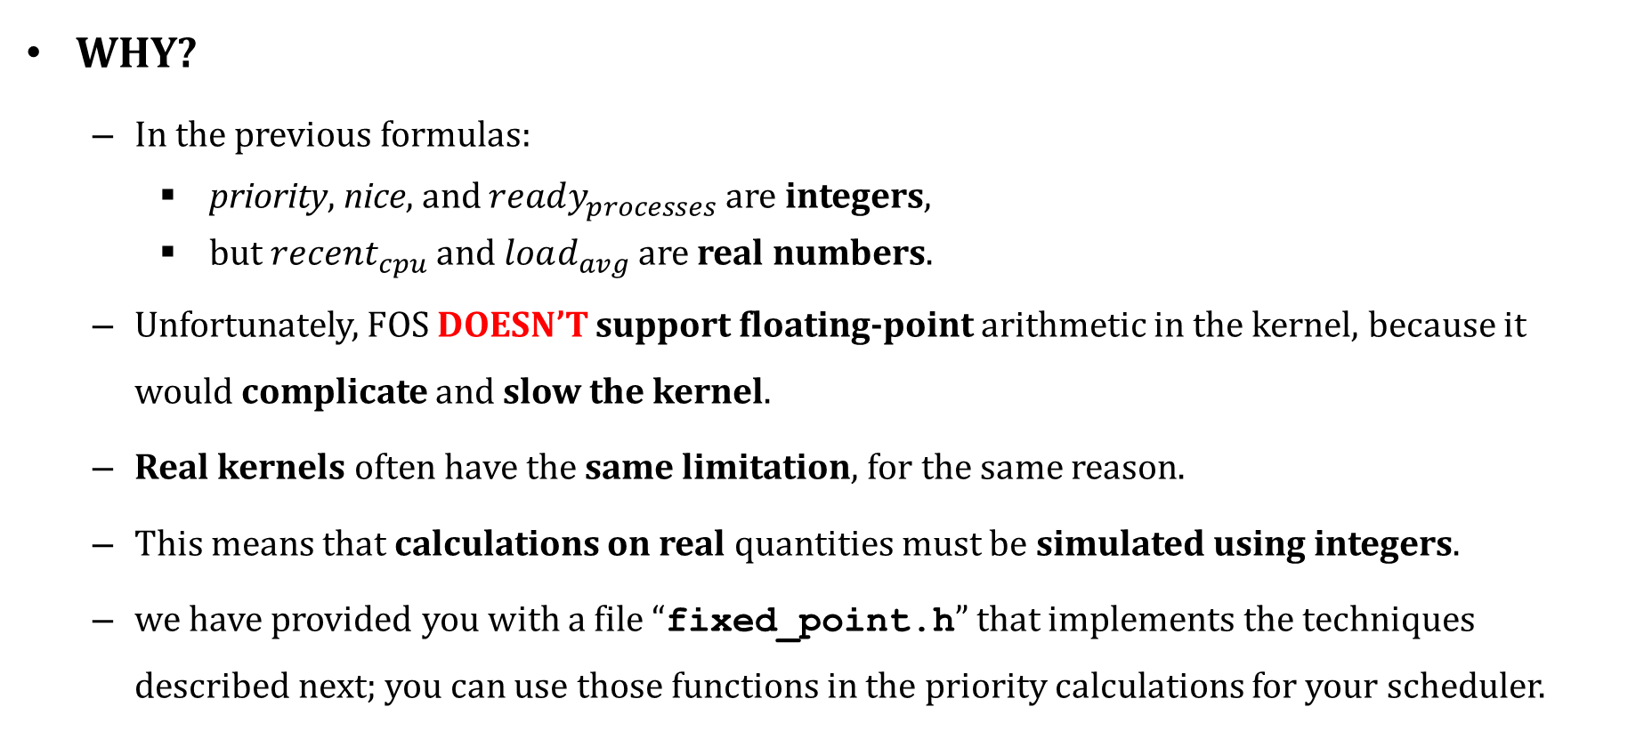
BSD Scheduler: Fixed Point Real Arithm.
WHY?
In the previous formulas:
priority, nice, and $ready_{processes}$are integers,
but $recent_{cpu}$and $load_{avg}$are real numbers.
Unfortunately, FOS DOESN’T support floating-point arithmetic in the kernel, because it would complicate and slow the kernel.
Real kernels often have the same limitation, for the same reason.
This means that calculations on real quantities must be simulated using integers.
we have provided you with a file “fixed_point.h” that implements the techniques described next; you can use those functions in the priority calculations for your scheduler.

Slide 46
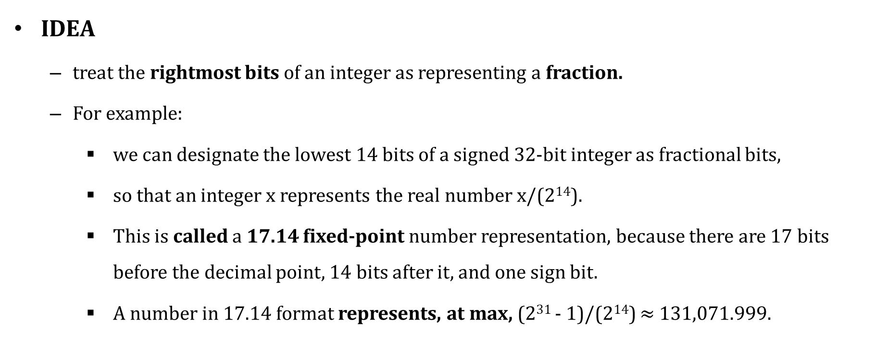
BSD Scheduler: Fixed Point Real Arithm.
IDEA
treat the rightmost bits of an integer as representing a fraction.
For example:
we can designate the lowest 14 bits of a signed 32-bit integer as fractional bits,
so that an integer x represents the real number x/(2¹⁴).
This is called a 17.14 fixed-point number representation, because there are 17 bits before the decimal point, 14 bits after it, and one sign bit.
A number in 17.14 format represents, at max, (2³¹ - 1)/(2¹⁴) $≈$ 131,071.999.
integer
Fraction
32-bit integer
17-bit
14-bit

Slide 47

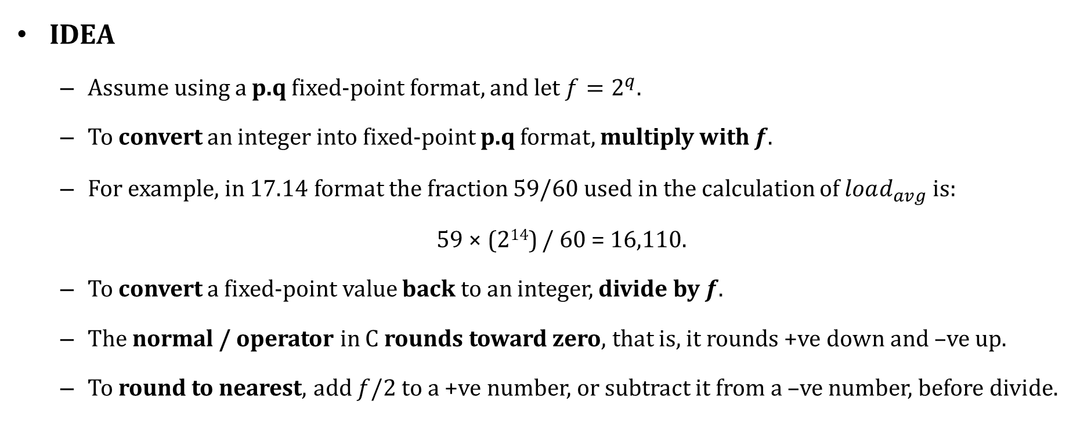

BSD Scheduler: Fixed Point Real Arithm.
Fraction
IDEA
Assume using a p.q fixed-point format, and let $f=2^{q}$.
To convert an integer into fixed-point p.q format, multiply with $f$.
For example, in 17.14 format the fraction 59/60 used in the calculation of $load_{avg}$ is:
59 × (2¹⁴) / 60 = 16,110.
To convert a fixed-point value back to an integer, divide by $f$.
The normal / operator in C rounds toward zero, that is, it rounds +ve down and –ve up.
To round to nearest, add $f$/2 to a +ve number, or subtract it from a –ve number, before divide.
integer
32-bit integer
p-bit
q-bit
integer
$$×2^{q}$$
$$/2^{q}$$
integer
fraction

Slide 48
BSD Scheduler: Fixed Point Real Arithm.
OPERATIONS
Let x and y be fixed-point p.q numbers, and let n be an integer.
sum of x and y ➔ x + y
difference of x and y ➔ x – y
sum of x and n ➔ x + n × f
Difference of x and n ➔ x - n × f
product of x and n ➔ x × n
Quotient of x and n ➔ x / n
x
y
integer
fraction
integer
fraction
n
integer

Slide 49

BSD Scheduler: Fixed Point Real Arithm.
x
y
OPERATIONS
Multiplying two fixed-point values (x & y) has two complications.
the decimal point of the result is q bits too far to the left. For example:
(59/60)×(59/60) should be slightly less than 1,
but in p.q format: 16,110×16,110 = 259,564,321 is much greater than 2¹⁴ = 16,384.
SOL: Shifting q bits right, we get 259,564,321/(2¹⁴) = 15,842, or ~ 0.97, the correct answer.
the multiplication can overflow even though the answer is representable. For example:
64 in 17.14 format is 64×2¹⁴ = 1,048,576,
its square 64² = 4,096 is well within 17.14 range,
its square in 17.14 format is (1,048,576)² = 2⁴⁰, greater than the max signed 32-bit int.
SOL: do the multiplication as a 64-bit operation.
The product of x and y is then ((int64) x) × y / f.
integer
fraction
$$×$$
integer
fraction

Slide 50

BSD Scheduler: Fixed Point Real Arithm.
x
y
OPERATIONS
Dividing two fixed-point values (x & y) has opposite issues.
the decimal point of the result is q bits too far to the right.
SOL: which we fix by shifting the dividend q bits to the left before the division.
The left shift discards the top q bits of the dividend.
SOL: which we can again fix by doing the division in 64 bits.
The quotient of x and y is then ((int64) x) × f / y.
integer
fraction
$$/$$
integer
fraction

Slide 51
BSD Scheduler: Fixed Point Real Arithm.
OPERATIONS – SUMMARY
Let x and y be fixed-point p.q numbers, let n be an integer, and f is 1 << q
Convert n to fixed point: | n × f | fix_int(int n)
Convert x to integer (rounding toward zero): | x / f | fix_trunc(fixed_point_t x)
Convert x to integer (rounding to nearest): | (x + f / 2) / f if x >= 0, (x - f / 2) / f if x <= 0. | fix_round(fixed_point_t x)
Add x and y: | x + y | fix_add(fixed_point_t x, fixed_point_t y)
Subtract y from x: | x – y | fix_sub(fixed_point_t x, fixed_point_t y)
Add x and n: | x + n × f
Subtract n from x: | x - n × f
Multiply x by y: | ((int64) x) × y / f | fix_mul(fixed_point_t x, fixed_point_t y)
Multiply x by n: | x × n | fix_scale(fixed_point_t x, int n)
Divide x by y: | ((int64) x) × f / y | fix_mul(fixed_point_t x, fixed_point_t y)
Divide x by n: | x / n | fix_unscale(fixed_point_t x, int n)

Slide 52
#4: new SysCall to Set Nice Value
Description:
Implement and handle a new system call to set the nice value of the user process during its run
Should call the env_set_nice(…) from the kernel
Should be named as sys_env_set_nice(…)
Refer to MS#1 for steps
Testing:
Will be tested during the other tests…

Slide 53
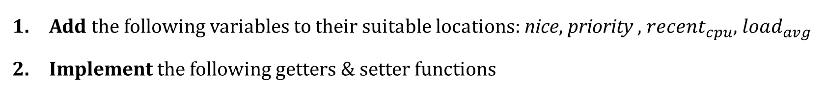
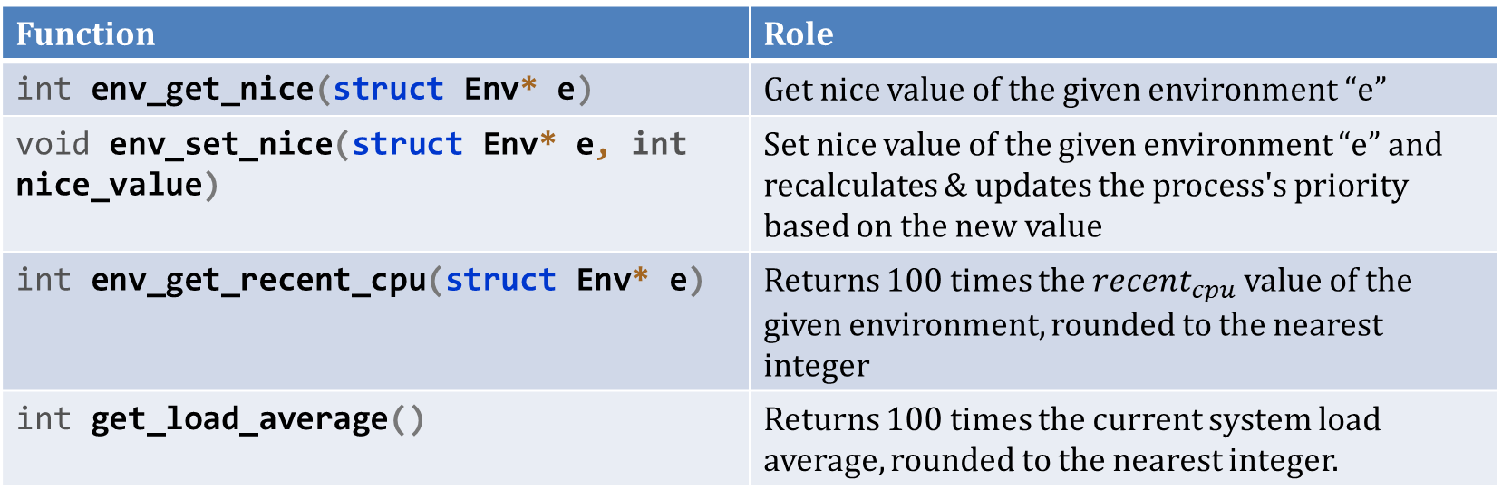
#5: Getters & Setters
Add the following variables to their suitable locations: nice, priority , $recent_{cpu}$, $load_{avg}$
Implement the following getters & setter functions
Function | Role
int env_get_nice(struct Env* e) | Get nice value of the given environment “e”
void env_set_nice(struct Env* e, int nice_value) | Set nice value of the given environment “e” and recalculates & updates the process's priority based on the new value
int env_get_recent_cpu(struct Env* e) | Returns 100 times the $recent_{cpu}$ value of the given environment, rounded to the nearest integer
int get_load_average() | Returns 100 times the current system load average, rounded to the nearest integer.

Slide 54
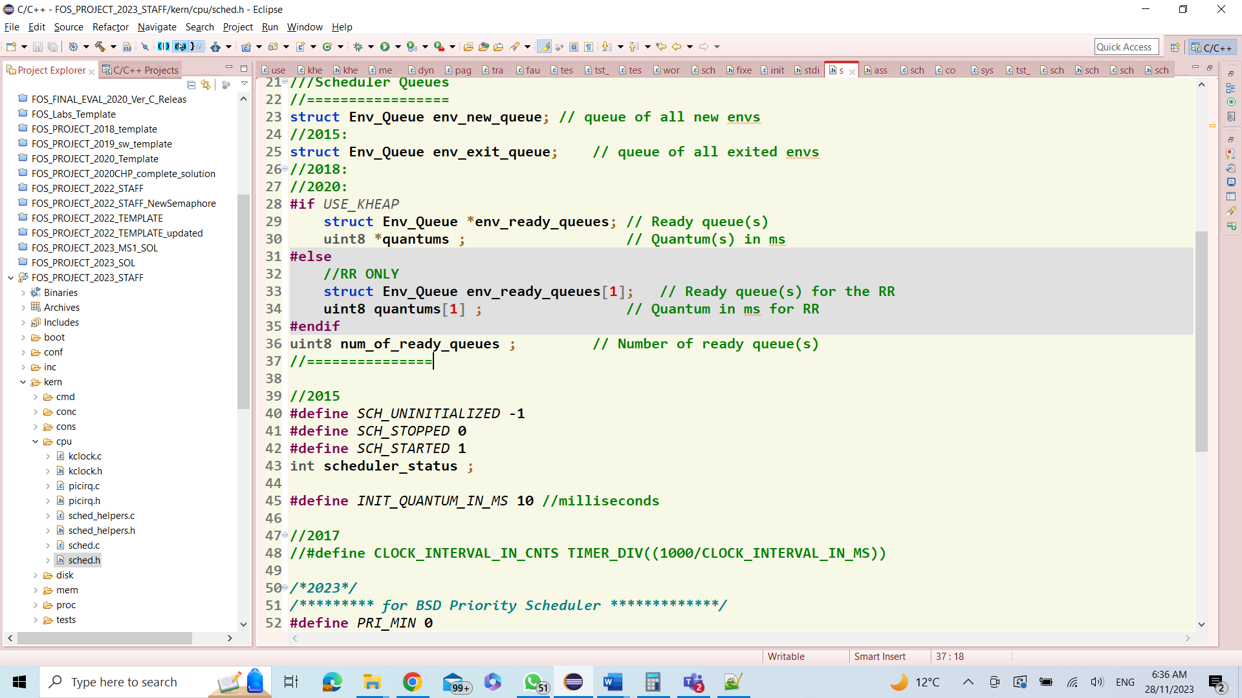
#6: Initialize Scheduler
Refer to APPENDICES for:
Scheduler Functions
void sched_init_BSD(uint8 numOfLevels, uint8 quantum)
Description:
Initialize the BSD scheduler by the given number of levels & quantum (in millisecond)
Do other initializations (if any)
Should use the following global variables for the initialization (declared in kern/cpu/sched.h)

Slide 55
#7: Schedule Next Env
Refer to APPENDICES for:
Scheduler Functions
struct Env* fos_scheduler_BSD()
Description:
Select the next environment to be run on the CPU and return it
the scheduler chooses a process from the highest-priority non-empty queue.

Slide 56
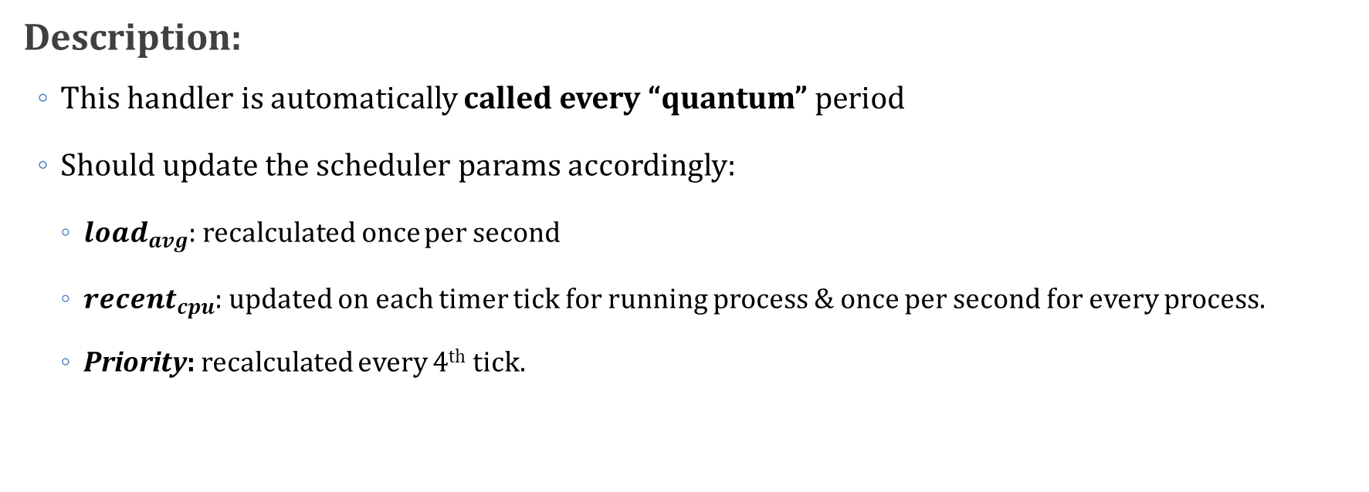
#8: Timer Tick Handler
Refer to APPENDICES for:
Scheduler Functions
void clock_interrupt_handler()
Description:
This handler is automatically called every “quantum” period
Should update the scheduler params accordingly:
$load_{avg}$: recalculated once per second
$recent_{cpu}$: updated on each timer tick for running process & once per second for every process.
Priority: recalculated every 4th tick.
REMEMBER: Use Fixed-Point Arithmetic during your Calculations

Slide 57
User Heap: Testing
Refer to APPENDICES for:
Ready-Made Commands
Scheduler Functions
UNSEEN Tests…
As a guide, you can use the given set of ready-made programs to test the following aspects:
Load & run multiple instances from the same program with different “nice” values
Load & run different set of programs with same or different “nice” values and compare!
Write a master program that create & run a large number of different processes with different needs (i.e. cpu, I/O, memory).
Use sys_create_env() and sys_run_env()
…

Slide 58
Agenda
Logistics
Part 0: Code Updates
Part 1: Fault Handler II
FIFO Replacement
Approx. LRU Replacement
Part 2: BSD Scheduler
OVERALL Testing
BONUSES
Summary & Quick Guide
How to submit?

Slide 59
Modular Tests: Dependency Graph
Dynamic Allocator
Kernel Heap
Invalid Access
(invalid ptrs)
PLACEMENT (tpp)
LRU List Approx.
BSD Scheduler
Malloc2
(BLOCK ALLOC)
Malloc1
(PAGE ALLOC)
tpr2 (STACK)
tpr1 (ALLOC)
Place.#1 (tpplru1)
Place.#2 (tpplru2)
Place.#3 (tpplru3)
Free2
(BLOCK ALLOC)
Free1
(PAGE ALLOC)
tfifo1 (WS)
Replace.#1 (tprlru1)
First Fit 2
(BLOCK ALLOC)
First Fit 1
(PAGE ALLOC)
tfifo2
(WS after free)
Replace.#2 (tprlru2)
Replace.#3 (tprlru3)

Slide 60
Project ENTIRE Tests: Intro
GIVEN
Set of ready-made C programs to test the entire project in different scenarios
REQUIRED
Use these programs to test & validate that the project will run successfully
EVALUATION
FIVE UNSEEN Scenarios (1 mark/each). The time limit of each one: max of 1 min / each

Slide 61
Project ENTIRE Tests: Programs
To run each program:
FIFO: FOS> run [prog name] [WS Size]
LRU: FOS> run [prog name] [Total WS Size] [2nd List Size]
I | Program | Params to Play With!
1 | fos_factorial.c (fact): calculate the factorial of the given integer (recursive code) | Input integer Working set size LRU lists size
2 | fos_fibonacci.c (fib): calculate the Fibonacci value of the given index (recursive code) | Fibonacci index Working set size LRU lists size
3 | quicksort_noleakage.c (qs): apply the quick-sort recursive algorithm to sort a pre-initialized array of the given size (using malloc()). The created array will be deleted every time (using free()) | Array size Initializ. (Asc, Desc, Random) Working set size LRU lists size

Slide 62
Project ENTIRE Tests: Programs
To run each program:
FIFO: FOS> run [prog name] [WS Size]
LRU: FOS> run [prog name] [Total WS Size] [2nd List Size]
I | Program | Params to Play With!
4 | mergesort_noleakage.c (ms1): apply the merge-sort recursive algorithm to sort a pre-initialized array of the given size (using malloc()). The auxiliary arrays in the “Merge” function are deleted every time (using free()) | Array size Initializ. (Asc, Desc, Random) Working set size LRU lists size
5 | mergesort_leakage.c (ms2): apply the merge-sort recursive algorithm to sort a pre-initialized array of the given size (using malloc()). The auxiliary arrays in the “Merge” function are NOT deleted (i.e. causing memory leakage) | Array size Initializ. (Asc, Desc, Random) Working set size LRU lists size

Slide 63
Project ENTIRE Tests: Scenarios
Possible Scenarios:
Run Single Program with Different Params
Can be used to test ALL Modules except CPU scheduling
To Run any program:
FIFO: FOS> run [prog name] [WS Size]
LRU: FOS> run [prog name] [Total WS Size] [2nd List Size]
Some Example Scenarios
Test the same program with different WS sizes (very small, medium, large and very large sizes)
Compare LRU vs. FIFO on different WS sizes
Compare mem-leakage program vs. non-leaky ones (e.g. mergesort)

Slide 64
Project ENTIRE Tests: Scenarios
Possible Scenarios:
Run Multi-Programs at the Same Time with Different Params
Can be used to test ALL Modules including CPU scheduling
To load multiple programs & run them at once:
FOS> load [prog#1] [WS Size]
FOS> load [prog#2] [WS Size]
…
FOS> runall
Some Example Scenarios
Run set of programs with different requirements (different memory, cpu, I/O…)
Run set of programs with different priority (i.e. “nice” value)

Slide 65
Bonuses

Slide 66
Bonuses
1. Free the entire environment (exit)
All pages in the page working set (or LRU lists)
Working set itself (or LRU lists)
All page tables in the entire user virtual memory
Directory table
All pages from page file, this code is already written for you ☺

Slide 67
Bonuses
Alone
With #1
2. Freeing RAM when it's Full
When allocating new frame, if there's no free frame, then you should:
remove one or more of the exited processes, if any, from the main memory (those with status ENV_EXIT)
If not, then you should free at least 1 frame from the second list of user working set of EACH process

Slide 68
Bonuses
3. O(1) Implementation of LRU Fault Handler
Implement the main logic of LRU re/placement in O(1)
Neglecting complexity of read/write from/to page file
Compare the performance of this implementation with the naïve one

Slide 69
Bonuses
4. FOS Enhancement
If you discover any issue in the FOS:
Performance issue
Security/Protection issue
Any other technical issue to act as a real OS.
Try to get a solution for it. (no implementation, just the solution idea)
Fill-up this document with TWO main sections:
The issue explained in a detailed and clear way.
The solution explained in a detailed and clear way.
DELIVERY: Discuss it with the Lecturer in the Last Lecture isA

Slide 70

Agenda
Logistics
Part 0: Code Updates
Part 1: Fault Handler II
FIFO Replacement
Approx. LRU Replacement
Part 2: BSD Scheduler
OVERALL Testing
BONUSES
Summary & Quick Guide
How to submit?

Slide 71
Summary
Module | Function | Difficulty | Testing | Files
Fault Handler II | FIFO Replacement | L2 | FOS> run tpr1 11 FOS> run tpr2 6 FOS> run tfifo1 11 FOS> run tfifo2 11 | Kern/trap/fault_handler.c
 | Approx. LRU Placement | L2 | FOS> run tpplru1 20 2 FOS> run tpplru2 20 7 FOS> run tpplru3 20 7 | Kern/trap/trap.c
 | Approx. LRU Replacement | L2 | FOS> run tprlru1 10 5 FOS> run tprlru2 11 5 FOS> run tprlru3 6 3 | Kern/trap/fault_handler.c
"Congratulations!! test [TEST NAME] completed successfully.”
To ensure the test success, a congratulations message like this MUST appear without any ERROR messages or PANICs.

Slide 72
Summary
Module | Function | Difficulty | Testing | Files
BSD Scheduler | New SysCall to set nice | L1 | Use it during the other tests… | lib/syscall.c, kern/trap/trap.c, kern/trap/syscall.c, inc/syscall.h
 | Getters & Setter | L1 | Will be tested during the other tests… | kern/sched/sched_helpers.c
 | sched_init_BSD() | L1 | UNSEEN Tests | kern/sched/sched.c
System Calls | fos_scheduler_BSD() | L2 | FOS> run tm1 ➔ malloc PAGE ALLOC FOS> run tm2 ➔ malloc BLOCK ALLOC FOS> run tf1 ➔ free PAGE ALLOC FOS> run tf2 ➔ free BLOCK ALLOC FOS> run tff1 ➔ FF PAGE ALLOC FOS> run tff2 ➔ FF BLOCK ALLOC | lib/uheap.c kern/mem/chunk_operations.c
 | clock_interrupt_handler() | L3
Module | Testing | Evaluation
OVERALL TESTING | UNSEEN FIVE Testing Scenarios to test the entire project | 5 MARKS (1/each)

Slide 73
REMEMBER:
UPDATE YOUR CODE ACCORDING TO PREVIOUSLY DESCRIBED STEPS
READ ATATCHED APPENDICES FOR HELPER FUNCTIONS.

Slide 74
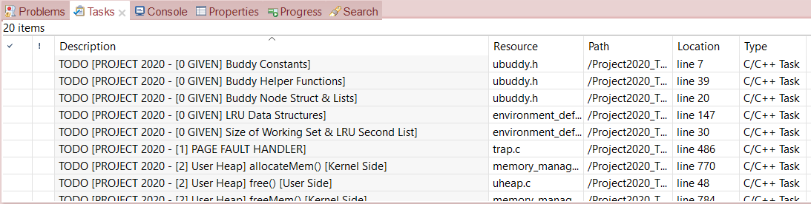
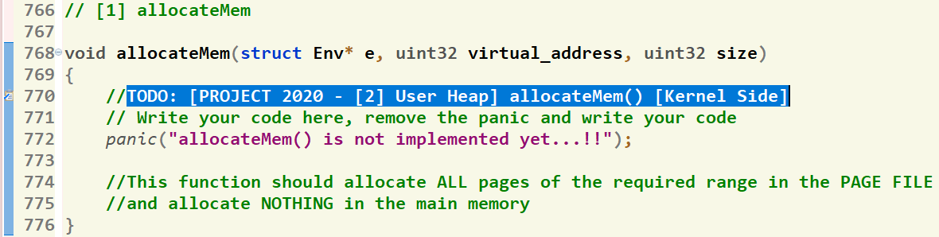
Where should I write the Code?
There’re shortcut links that direct you to the function definition
[1] Click on “Tasks” Tab
[2] Double Click on the required function
GIVEN
REQUIRED
[3] Function body, at which you should write the code
74

Slide 75
Submission Rules
Read the following instructions as the code correction is done AUTOMATICALLY. Any violation in these rules will lead to 0 and, in this case, nothing could be happened.
First ensure the following that (READ CAREFULLY):
You tested each function in a FRESH RUN and a congratulations message have been appeared.
NO CODE with errors WILL BE CORRECTED. So, CLEAN & RUN your project several times before your submission.
You submitted BEFORE the deadline by several hours to AVOID any internet problems.
DEADLINE: SAT of Week #12 (16/12 @11:59 PM)
NO DELAYED submissions WILL BE ACCEPTED.
ONLY ONE person from the team shall submit the code.
The TEAM # MUST BE CORRECT.
DON’T take the FORM LINK FROM ANYONE. OPEN the form from its LINK ONLY. Otherwise, your submission is AUTOMATICALLY CANCELLED by GOOGLE.
You MUST RECEIVE A MAIL FROM GOOGLE with your submission after clicking submit. If nothing received, re-submit again to consider your submission.

Slide 76
Submission Steps
STEPS to SUBMIT:
Step 1: Clean & run your code the last time to ensure that there are any errors.
Step 2: Create a new folder and name it by your team number ONLY. Example 1 or 95. [ANY extra chars will lead to 0].
Step 3: DELETE the “obj” folder from the “FOS_PROJECT_2023_Template”
Step 4: PASTE the “FOS_PROJECT_2023_Template” in the folder created in step #2.
Step 5: Zip the created new folder. Its name shall be like [num of your team.zip]. [ANY extra chars will lead to ZERO].
Step 6: Open the form from HERE.
Step 7: Fill your team’s info .. Any wrong information will cancel your submission, revise them well.
Step 8: Upload the zipped folder in step 5 to the form in its field.
Step 9: MUST RECEIVE A MAIL from GOOGLE with your submission, otherwise re-submit again.

Slide 77
Thank you for your care…
Enjoy making your own FOS ☺

